Slide 1
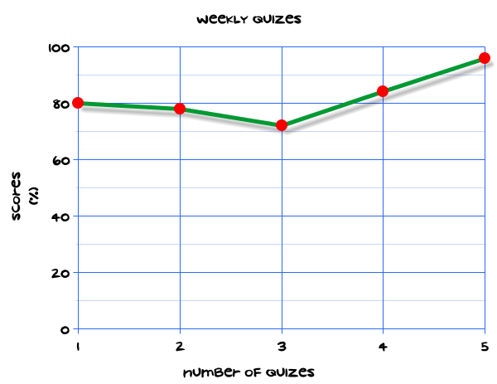
My Statistics Interactive Notebook
Name
Class 10.4
Teacher Mrs Keen
Term 3 Semester 2
1

Slide 2
Create your own front page
It needs to contain the following –
My applications interactive notebook
Name
Class
Teachers Name
Semester 2 Term 2
Page number 1

Slide 3
Contents
Glossary or Formula Page
Page
Date
Description
2
3

Slide 4
Tasks
24
7
30
Essential Question
Questions
Notes
Summary
4
5

Slide 5
24
7
30
Date
Topic
Data
EQ – What is the difference between standard deviation and mean deviation?
5

Slide 6
24
7
30
Date
Topic
Data
EQ – What is the difference between standard deviation and mean deviation?
Averages are good for summarising data but they don’t tell the whole story. We also need measures of dispersion (spread).
5

Slide 7
24
7
30
Date
Topic
Data
EQ – What is the difference between standard deviation and mean deviation?
Averages are good for summarising data but they don’t tell the whole story. We also need measures of dispersion (spread).
Range only takes 2 pieces of data into account and is not that useful.
5

Slide 8
24
7
30
Date
Topic
Data
EQ – What is the difference between standard deviation and mean deviation?
Averages are good for summarising data but they don’t tell the whole story. We also need measures of dispersion (spread).
Range only takes 2 pieces of data into account and is not that useful.
Mean Deviation: the average of the absolute values of the deviations.
5

Slide 9
24
7
30
Date
Topic
Data
EQ – What is the difference between standard deviation and mean deviation?
Averages are good for summarising data but they don’t tell the whole story. We also need measures of dispersion (spread).
Range only takes 2 pieces of data into account and is not that useful.
Mean Deviation: the average of the absolute values of the deviations.
Variance: the average of the square deviations.
5

Slide 10
24
7
30
Date
Topic
Data
EQ – What is the difference between standard deviation and mean deviation?
Averages are good for summarising data but they don’t tell the whole story. We also need measures of dispersion (spread).
Range only takes 2 pieces of data into account and is not that useful.
Mean Deviation: the average of the absolute values of the deviations.
Variance: the average of the square deviations.
Standard Deviation: the square root of the variance.
5

Slide 11
24
7
30
Date
Topic
Data
EQ – What is the difference between standard deviation and mean deviation?
Averages are good for summarising data but they don’t tell the whole story. We also need measures of dispersion (spread).
Range only takes 2 pieces of data into account and is not that useful.
Mean Deviation: the average of the absolute values of the deviations.
Variance: the average of the square deviations.
Standard Deviation: the square root of the variance.
Standard Deviation is the more commonly used measure of dispersion in data analysis.
5

Slide 12
24
7
30
Date
Topic
Data
EQ – What is the difference between standard deviation and mean deviation?
Averages are good for summarising data but they don’t tell the whole story. We also need measures of dispersion (spread).
Range only takes 2 pieces of data into account and is not that useful.
Mean Deviation: the average of the absolute values of the deviations.
Variance: the average of the square deviations.
Standard Deviation: the square root of the variance.
Standard Deviation is the more commonly used measure of dispersion in data analysis.
All well and good but I think we might need an example!…
5

Slide 13
24
7
30
Date
Topic
Data
EQ – What is the difference between standard deviation and mean deviation?
Averages are good for summarising data but they don’t tell the whole story. We also need measures of dispersion (spread).
Range only takes 2 pieces of data into account and is not that useful.
Mean Deviation: the average of the absolute values of the deviations.
Variance: the average of the square deviations.
Standard Deviation: the square root of the variance.
Standard Deviation is the more commonly used measure of dispersion in data analysis.
All well and good but I think we might need an example!… Yes please! ☺
5

Slide 14
Example
Team A Heights (mean 184cm)
Player | Height (cm) | Deviation from the mean | =
1 | 211 | 211 – 184 | 27
2 | 184 | 184 – 184 | 0
3 | 184 | 184 – 184 | 0
4 | 172 | 172 – 184 | -12
5 | 169 | 169 - 184 | -15
* IGNORE the negative signs when we use absolute values

Slide 15
Example
Team A Heights (mean 184cm)
Player | Height (cm) | Deviation from the mean | =
1 | 211 | 211 – 184 | 27
2 | 184 | 184 – 184 | 0
3 | 184 | 184 – 184 | 0
4 | 172 | 172 – 184 | -12
5 | 169 | 169 - 184 | -15

Slide 16
Example
Team A Heights (mean 184cm)
Player | Height (cm) | Deviation from the mean | =
1 | 211 | 211 – 184 | 27
2 | 184 | 184 – 184 | 0
3 | 184 | 184 – 184 | 0
4 | 172 | 172 – 184 | -12
5 | 169 | 169 - 184 | -15
Mean Deviation

Slide 17
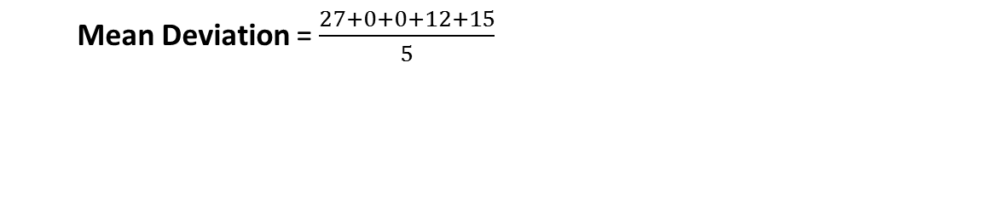
Example
Team A Heights (mean 184cm)
Player | Height (cm) | Deviation from the mean | =
1 | 211 | 211 – 184 | 27
2 | 184 | 184 – 184 | 0
3 | 184 | 184 – 184 | 0
4 | 172 | 172 – 184 | -12
5 | 169 | 169 - 184 | -15
Mean Deviation = $\frac{27+0+0+12+15}{5}$

Slide 18
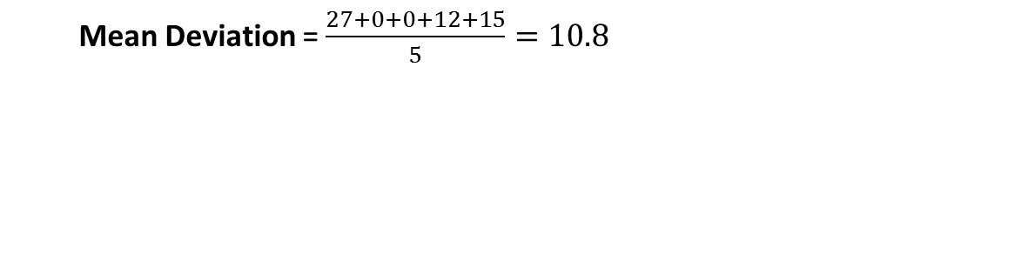
Example
Team A Heights (mean 184cm)
Player | Height (cm) | Deviation from the mean | =
1 | 211 | 211 – 184 | 27
2 | 184 | 184 – 184 | 0
3 | 184 | 184 – 184 | 0
4 | 172 | 172 – 184 | -12
5 | 169 | 169 - 184 | -15
Mean Deviation = $\frac{27+0+0+12+15}{5}=10.8$

Slide 19
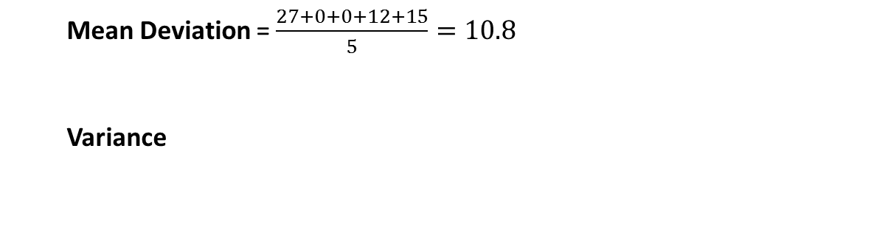
Example
Team A Heights (mean 184cm)
Player | Height (cm) | Deviation from the mean | =
1 | 211 | 211 – 184 | 27
2 | 184 | 184 – 184 | 0
3 | 184 | 184 – 184 | 0
4 | 172 | 172 – 184 | -12
5 | 169 | 169 - 184 | -15
Mean Deviation = $\frac{27+0+0+12+15}{5}=10.8$
Variance

Slide 20
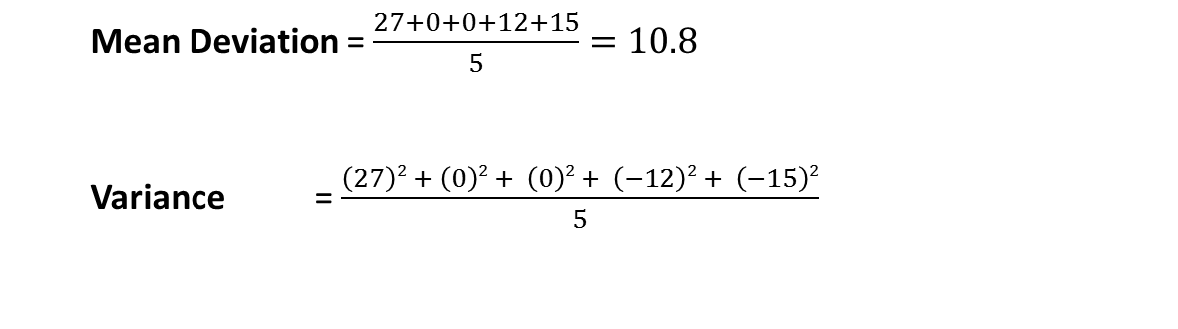
Example
Team A Heights (mean 184cm)
Player | Height (cm) | Deviation from the mean | =
1 | 211 | 211 – 184 | 27
2 | 184 | 184 – 184 | 0
3 | 184 | 184 – 184 | 0
4 | 172 | 172 – 184 | -12
5 | 169 | 169 - 184 | -15
Mean Deviation = $\frac{27+0+0+12+15}{5}=10.8$
Variance = $\frac{\left(27\right)2 + \left(0\right)2 + \left(0\right)2 + \left(−12\right)2 + \left(−15\right)2}{5}$

Slide 21
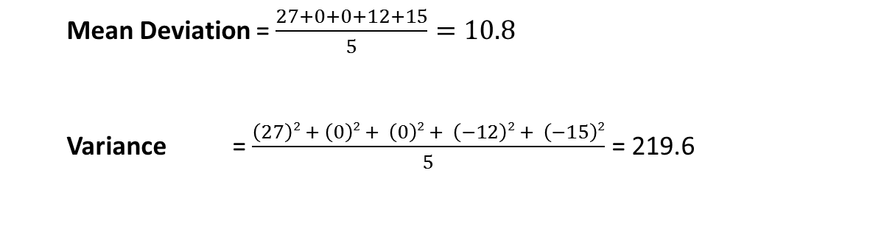
Example
Team A Heights (mean 184cm)
Player | Height (cm) | Deviation from the mean | =
1 | 211 | 211 – 184 | 27
2 | 184 | 184 – 184 | 0
3 | 184 | 184 – 184 | 0
4 | 172 | 172 – 184 | -12
5 | 169 | 169 - 184 | -15
Mean Deviation = $\frac{27+0+0+12+15}{5}=10.8$
Variance = $\frac{\left(27\right)2 + \left(0\right)2 + \left(0\right)2 + \left(−12\right)2 + \left(−15\right)2}{5}$ = 219.6

Slide 22
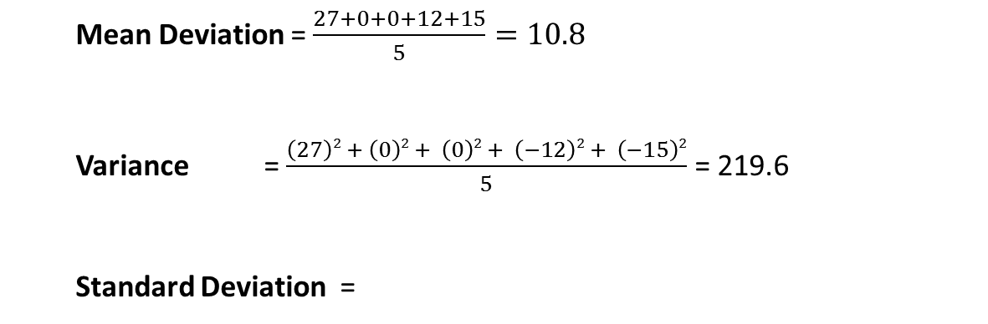
Example
Team A Heights (mean 184cm)
Player | Height (cm) | Deviation from the mean | =
1 | 211 | 211 – 184 | 27
2 | 184 | 184 – 184 | 0
3 | 184 | 184 – 184 | 0
4 | 172 | 172 – 184 | -12
5 | 169 | 169 - 184 | -15
Mean Deviation = $\frac{27+0+0+12+15}{5}=10.8$
Variance = $\frac{\left(27\right)2 + \left(0\right)2 + \left(0\right)2 + \left(−12\right)2 + \left(−15\right)2}{5}$ = 219.6
Standard Deviation =

Slide 23
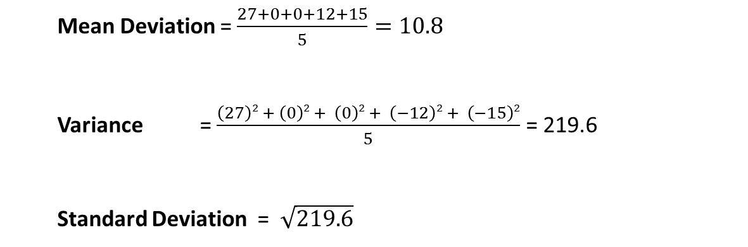
Example
Team A Heights (mean 184cm)
Player | Height (cm) | Deviation from the mean | =
1 | 211 | 211 – 184 | 27
2 | 184 | 184 – 184 | 0
3 | 184 | 184 – 184 | 0
4 | 172 | 172 – 184 | -12
5 | 169 | 169 - 184 | -15
Mean Deviation = $\frac{27+0+0+12+15}{5}=10.8$
Variance = $\frac{\left(27\right)2 + \left(0\right)2 + \left(0\right)2 + \left(−12\right)2 + \left(−15\right)2}{5}$ = 219.6
Standard Deviation = $\sqrt{219.6}$

Slide 24
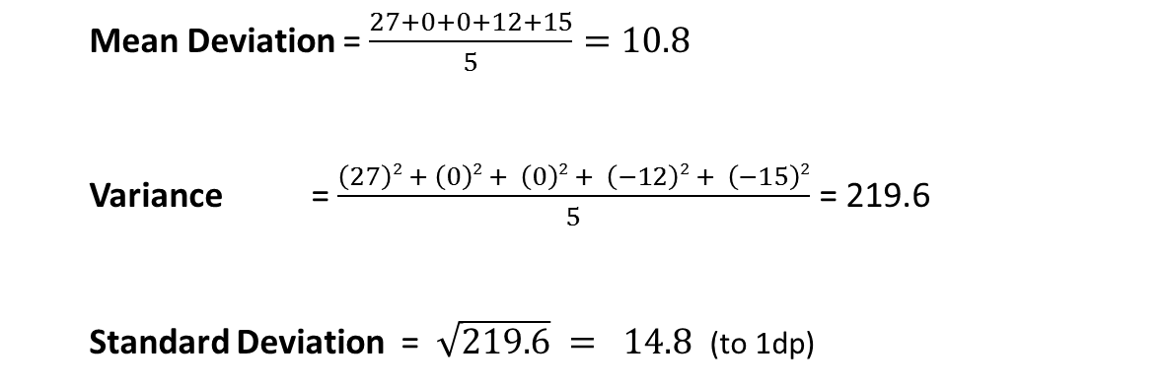
Example
Team A Heights (mean 184cm)
Player | Height (cm) | Deviation from the mean | =
1 | 211 | 211 – 184 | 27
2 | 184 | 184 – 184 | 0
3 | 184 | 184 – 184 | 0
4 | 172 | 172 – 184 | -12
5 | 169 | 169 - 184 | -15
Mean Deviation = $\frac{27+0+0+12+15}{5}=10.8$
Variance = $\frac{\left(27\right)2 + \left(0\right)2 + \left(0\right)2 + \left(−12\right)2 + \left(−15\right)2}{5}$ = 219.6
Standard Deviation = $\sqrt{219.6} = 14.8$ (to 1dp)

Slide 25
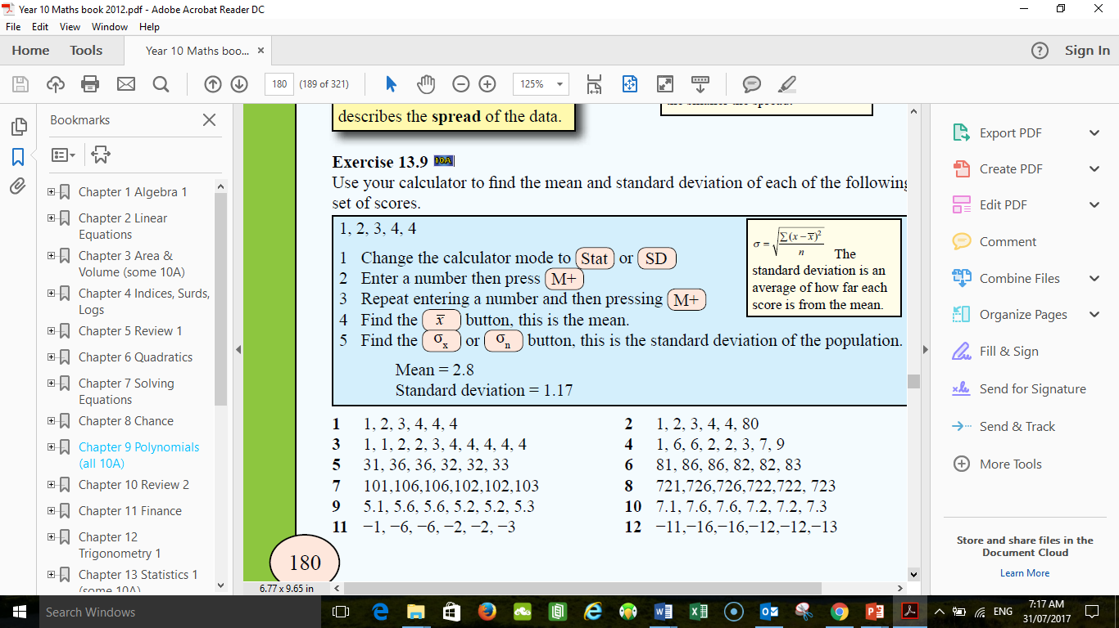

Task
Find the mean and standard deviation for each of the following sets of scores.
and… SMILE!

Slide 26
Notes Review
24, 7 ,30
Date
Title
Essential question
Notes complete
Notes complete with colour and diagrams
Questions completed
Contents page filled in
Formula page filled in

Slide 27
Homework
Review your notes and write a summary answering the essential question.

